Slide 1
AI-Powered Personalized Workout & Diet Planner
CAPSTONE PROJECT
Presented By:
Student Name- HARIHARAN S
College Name- SRI KRISHNA COLLEGE OF TECHNOLOGY
Department- ARTIFICIAL INTELLIGENCE AND DATA SCIENCE (AI&DS)
AICTE Student ID- STU67d85e3af328e1742233146

Slide 2
OUTLINE
Problem Statement
Proposed System/Solution
System Development Approach (Technology Used)
Algorithm
Deployment & Requirements Installation
Result
Project Screenshot
Conclusion
Future Scope
References

Slide 3
Problem Statement
Problem Statement
Maintaining a healthy lifestyle requires proper workout planning and balanced nutrition. Many individuals struggle to create fitness routines and diet plans that align with their goals, body conditions, and daily schedules. Existing fitness resources often provide generic recommendations that fail to address individual needs.
Problems Identified:
Lack of personalized workout and diet recommendations.
Difficulty tracking fitness progress consistently.
Limited access to professional fitness guidance.
Time-consuming process of planning meals and workouts.
Poor motivation and adherence to fitness routines.
Lack of centralized fitness management tools.

Slide 4
Proposed Solution
AI-Powered Personalized Workout & Diet Planner
The proposed system is an intelligent fitness application that uses Artificial Intelligence to generate customized workout routines and diet plans based on user-specific fitness goals, body metrics, and lifestyle preferences.
Key Features
User Authentication & Profile Management
AI Workout Plan Generator & AI Diet Plan Generator.
AI Fitness Chatbot Coach & Progress Tracking.
Analytics Dashboard & PDF Report Generation.
Detailed Fitness Assessment
Benefits
Personalized fitness recommendations & Improved workout efficiency
Better nutrition planning & Progress monitoring and motivation
Easy access to fitness guidance

Slide 5
System Approach
Category | Technology
Frontend | Streamlit
Backend | Python
Database | SQLAlchemy (SQLite/PostgreSQL)
Artificial Intelligence Integration | Google Gemini API
Data Processing | Pandas
Data Visualization | Plotly
Authentication & Security | bcrypt
Report Generation | ReportLab
Environment Management | Virtual Environment (.venv)
Deployment | Docker
Version Control | Git & GitHub
Development IDE | Visual Studio Code

Slide 6
Algorithm
User Registration/Login
↓
Fitness Assessment
↓
Collect User Details
(Age, Weight, Height, Goal, Activity Level)
↓
Gemini AI Processing
↓
Workout Plan Generation
↓
Diet Plan Generation
↓
Progress Tracking
↓
Analytics Dashboard
↓
PDF Report Generation

Slide 7
Deployment & Requirements Installation
Create Virtual Environment
python -m venv venv
Activate Virtual Environment
Windows - (venv\Scripts\activate) & Linux/macOS - (source venv/bin/activate)
Install Required Packages
pip install -r requirements.txt
Verify Installation
pip list
Local Deployment
streamlit run app.py
Docker Deployment
docker build -t workout-diet-planner .
docker run -p 8501:8501 --env-file .env workout-diet-planner

Slide 8
Result
The application successfully generates personalized workout and diet recommendations based on user-specific fitness data. Users can track their progress, analyze performance trends, and receive AI-powered fitness guidance through an interactive chatbot.

Slide 9
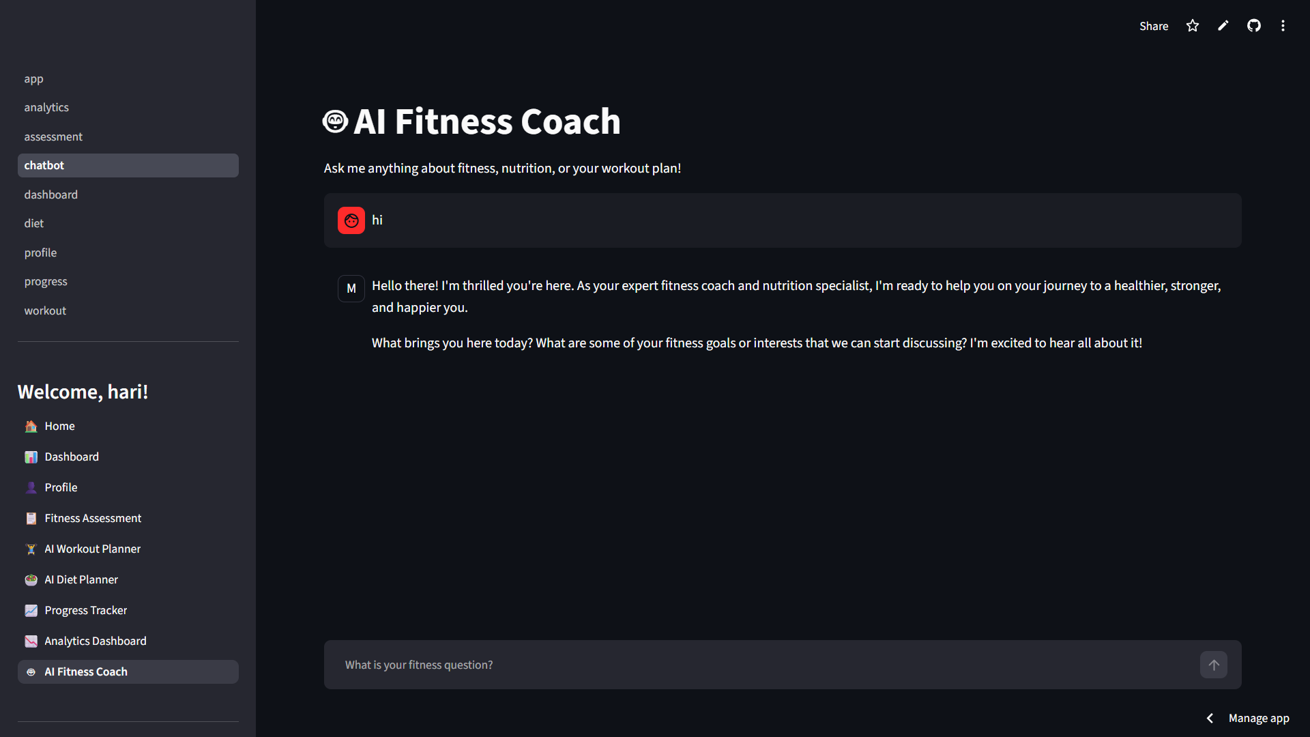
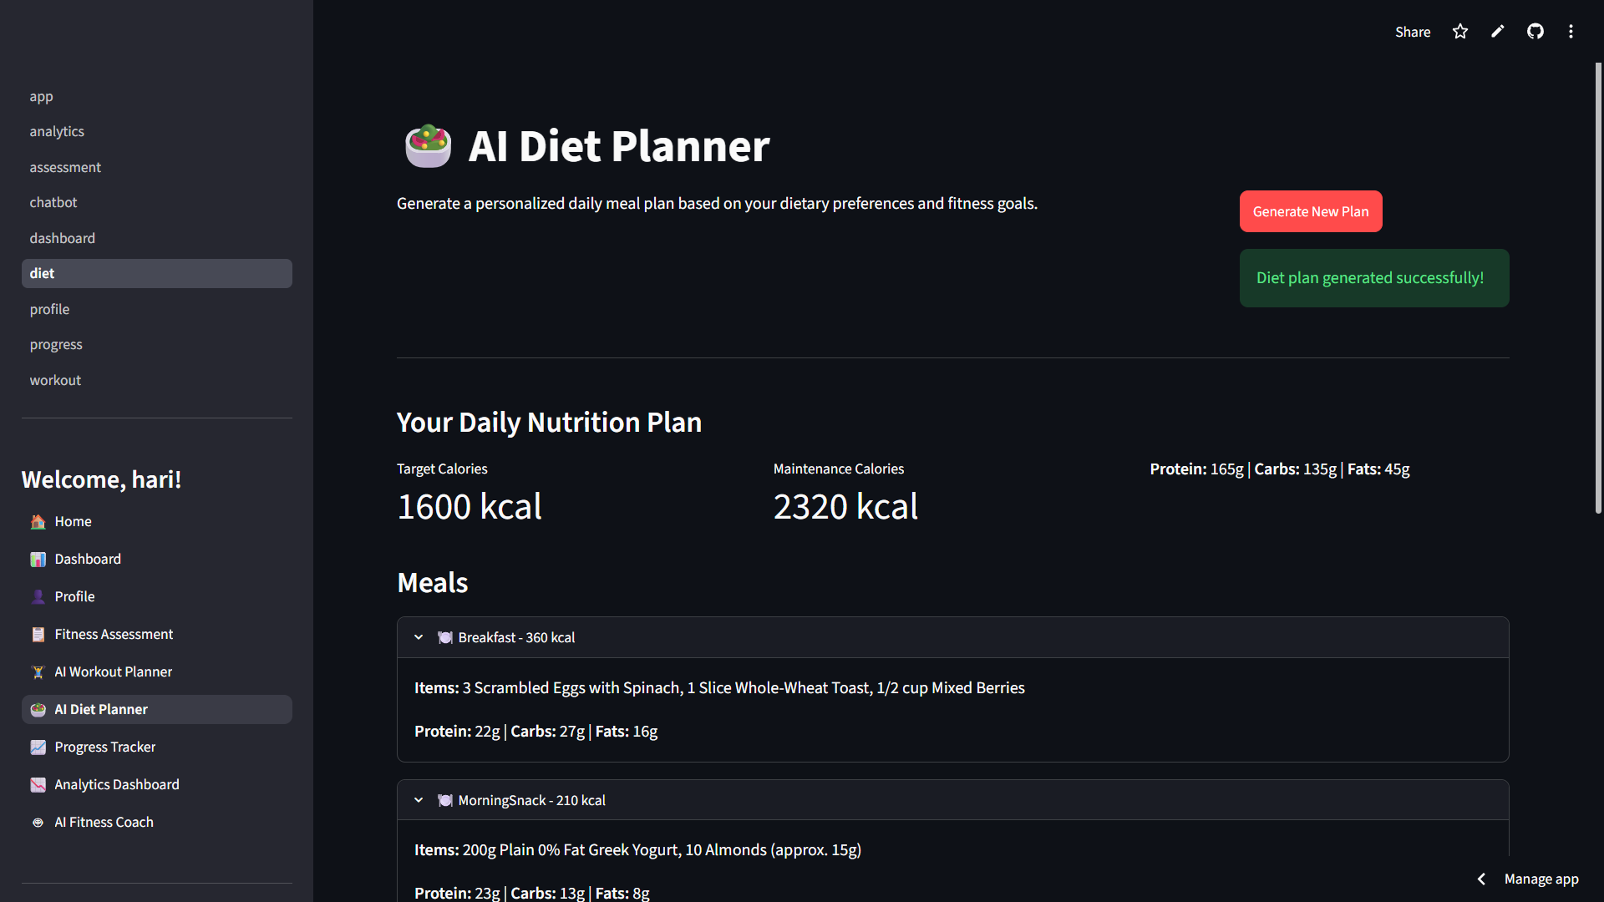
Project Screenshot

Slide 10
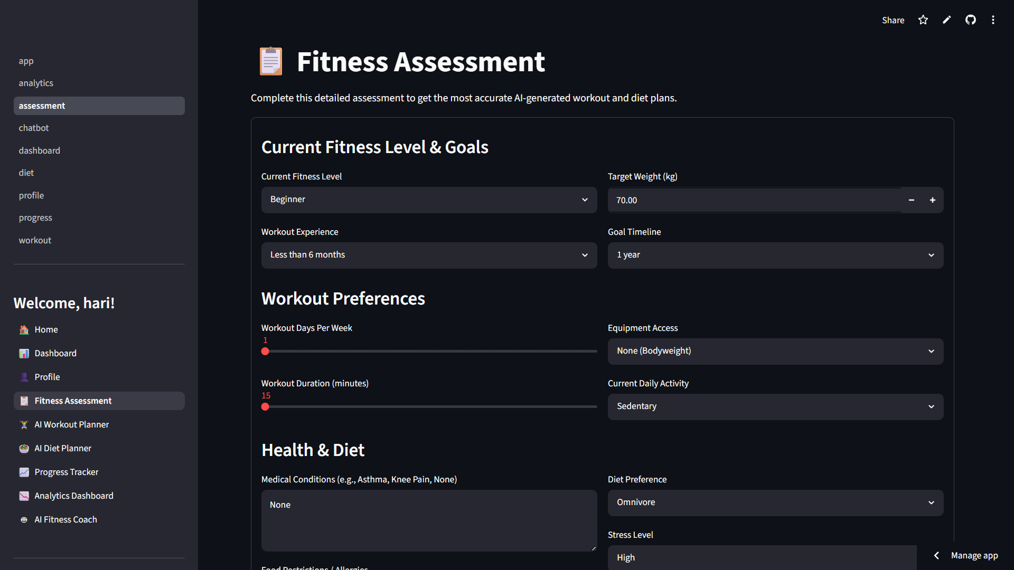
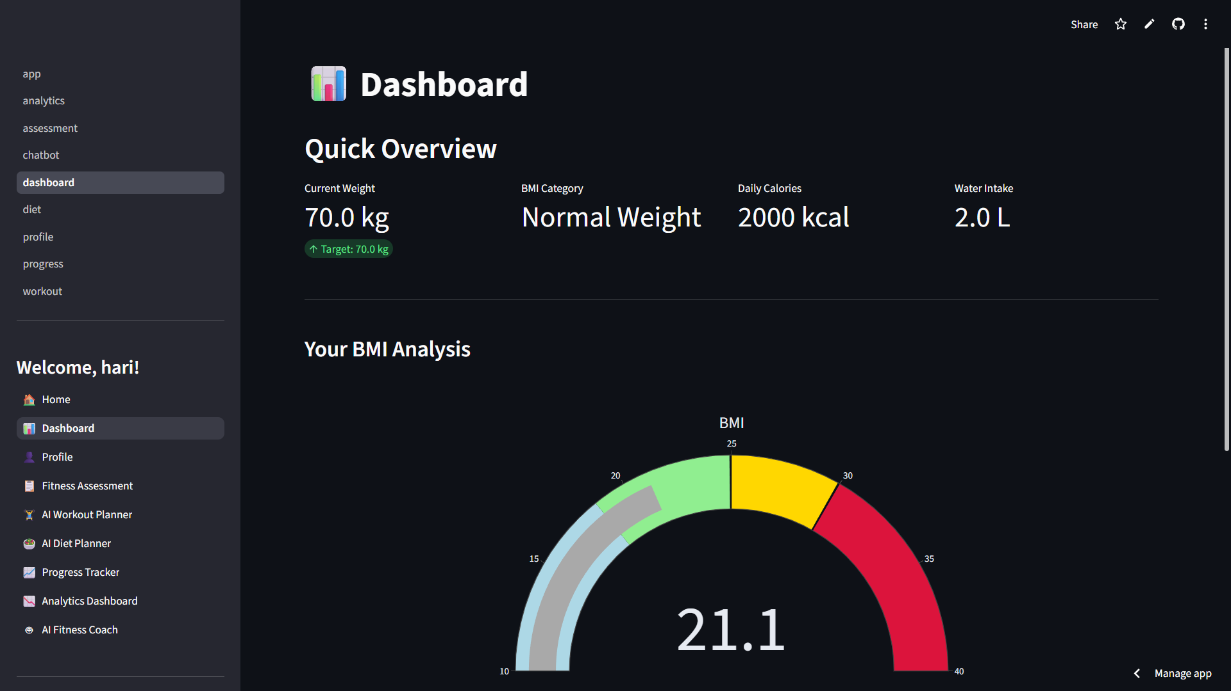
Project Screenshot

Slide 11
Conclusion
The AI-Powered Personalized Workout & Diet Planner successfully provides customized fitness and nutrition recommendations using Artificial Intelligence. The system simplifies fitness planning, improves user engagement, and enables effective progress monitoring through an intuitive and interactive platform.

Slide 12
Future scope
Integration with wearable fitness devices.
Real-time calorie tracking.
Exercise video recommendations.
Mobile application development.
Multi-language support.
AI-based injury prevention suggestions.
Integration with health monitoring systems.
Community fitness challenges and leaderboards.
Voice-enabled fitness assistant.
Advanced predictive health analytics.

Slide 13
References
Google Gemini Documentation. Available: https://ai.google.dev/
Python Documentation. Available: https://docs.python.org/
SQLAlchemy Documentation. Available: https://docs.sqlalchemy.org/
Streamlit Documentation. Available: https://docs.streamlit.io/
Supervised Learning — scikit-learn Documentation. Available: https://scikit-learn.org/stable/supervised_learning.html
Docker Documentation. Available: https://docs.docker.com/
Plotly Documentation. Available: https://plotly.com/python/
Pandas Documentation. Available: https://pandas.pydata.org/docs/
ReportLab Documentation. Available: https://docs.reportlab.com/
bcrypt Documentation. https://pypi.org/project/bcrypt/

Slide 14
Github link
Github Project Link: https://github.com/HARIHARANS24/AthletiQ-AI
Deployment Link: Streamlit - https://athletiq-ai.streamlit.app/
Github Profile Link: https://github.com/HARIHARANS24
Linkedin Profile Link: https://www.linkedin.com/in/hariharan-s24/

Slide 15
THANK YOU

